Slide 1



Class: IX Lab: 14
Python
Loops

Slide 2



Loops
Python has two primitive loop commands:
while loops
for loops

Slide 3
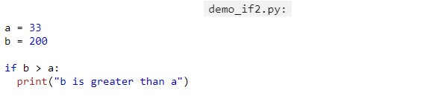

Python Loops
The basic of If
Statements

Slide 4
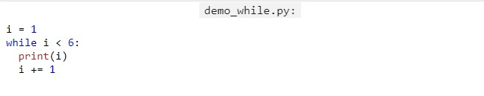
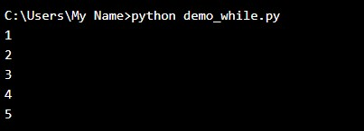
While Loop
With the while
loop we can
execute a set
of statements
as long as a
condition is true.

Slide 5
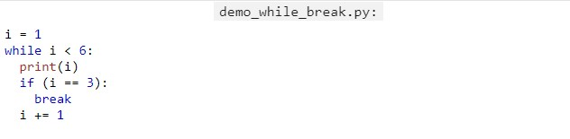
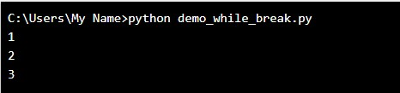
Break Statements
With the break
statement we
can stop the loop even if the while condition is true

Slide 6
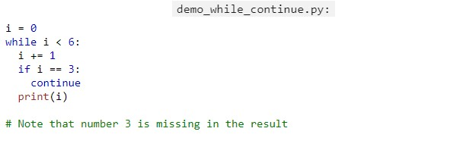
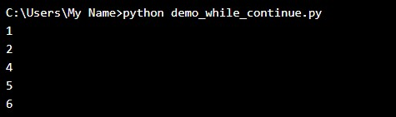
Continue Statement
With the continue
statement we can stop the current iteration, and continue with the next

Slide 7
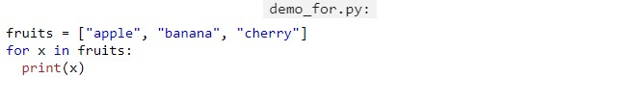
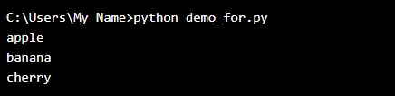
For Loops
A for loop is used for iterating over a sequence (that is either a list, a tuple, a dictionary, a set,
or a string).

Slide 8
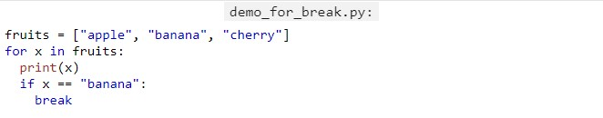

Break Statement
With the break statement we can stop the loop before it has looped through all the items

Slide 9
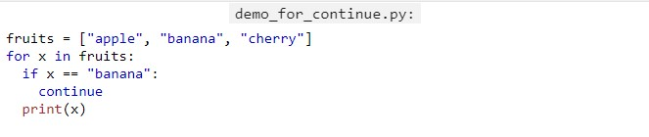
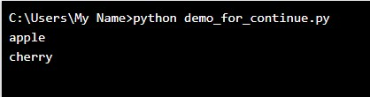
Continue Statement
With the continue statement we can stop the current iteration of the loop, and continue with the next

Slide 10
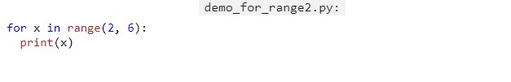
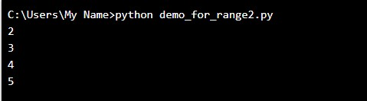
Range
To loop through a set of code a specified number of times, we can use the range() function

Slide 11
